Slide 1
NEURODIVERSITY
Minahil Haroon & Busayomi Dele-Lawal

Slide 2
Our Plan
Spread awareness and light onto the topic of Neurodiversity in the youth and our peers.

Slide 3
THE STEPS WE TOOK
01
Educate Ourselves
03
Follow-Up
02
Info Flyer
We used resources to educate ourselves about Neurodiversity.
We collaborated with students from our school to share what they learned.
We created a Flyer to put around our school.

Slide 4
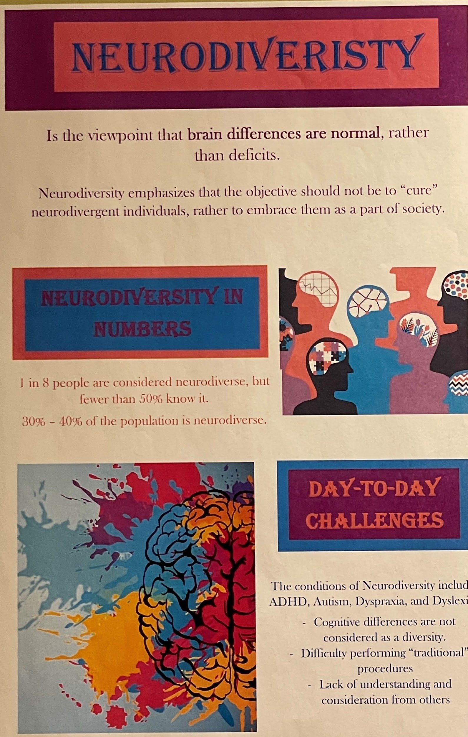
FLYER ON NEURODIVERSITY

Slide 5
01
Butler Tech Bioscience Center
Most students are planning to go into healthcare.

Slide 6
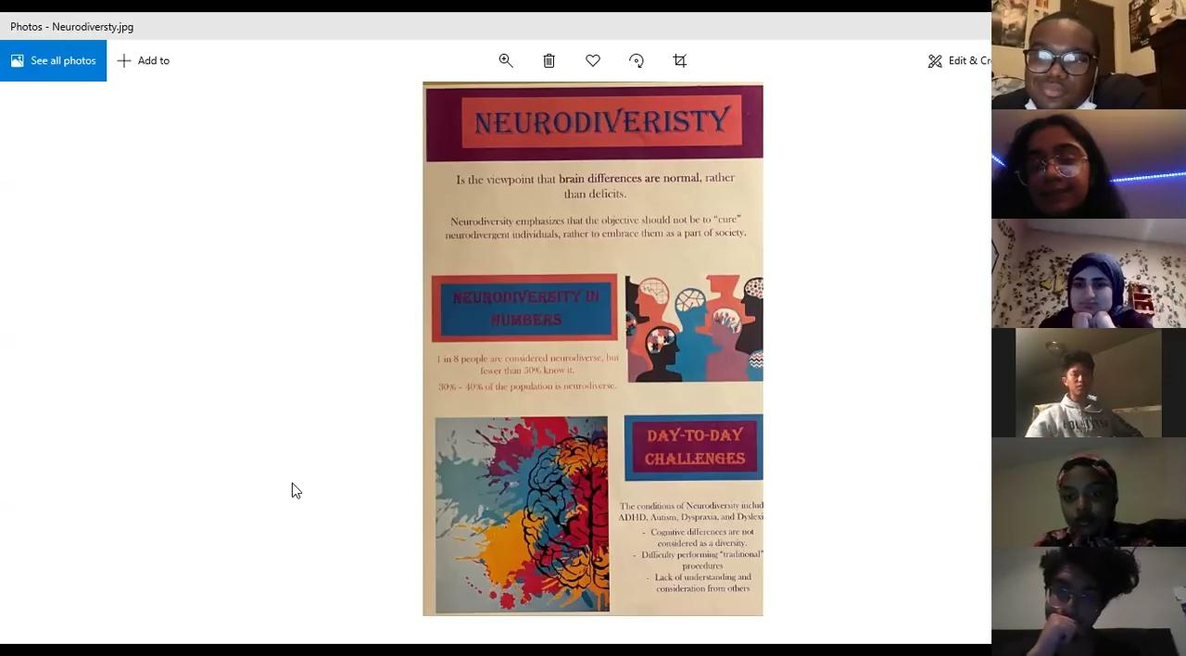

Slide 7
—Student In Zoom
“This is an important topic, definitely something I have never heard of.”

Slide 8
Going on...
We hope to spread as much more awareness as we possibly can! And empower more research into Neurodiversity.

